Slide 1
Dualformer: Controllable Fast and Slow Thinking by Learning with Randomized Reasoning Traces
FAIR at Meta
arXiv:2410.09918
Presented by Xin-Shuang Zhang

Slide 2

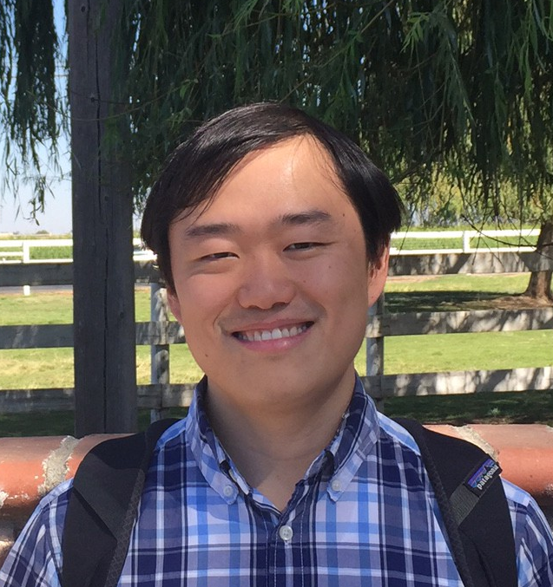
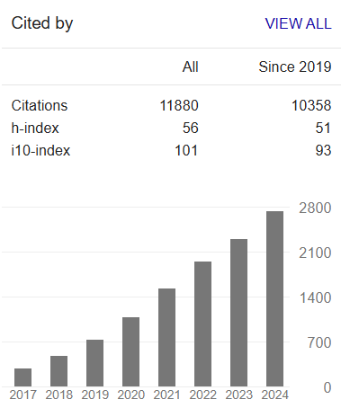
Authors
FAIR: The Fundamental AI Research team at le led by Yann LeCun
Yuandong Tian(田渊栋) is a Research Scientist Director in FAIR, leading the group of reasoning, planning and decision-making with Large Language Models (LLMs).
Research Directions: Decision-Making, Optimization, Representation Learning, LLMs

Slide 3



Section 1
Preliminaries

Slide 4
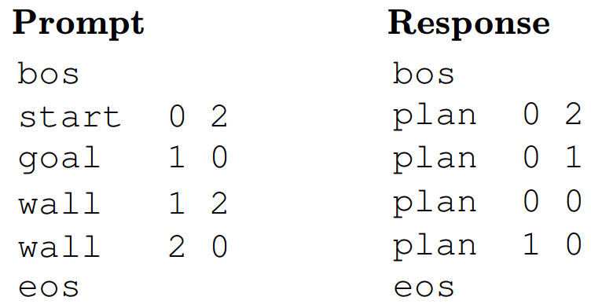
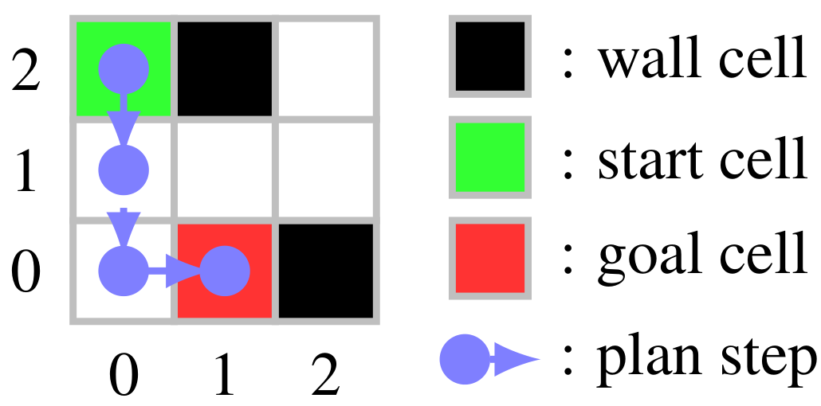
Maze Navigation Task
The goal is to find the shortest path from start cell to goal cell without entering a wall cell.
Maze
task
Tokenization
AI model to perform planning?
solution

Slide 5
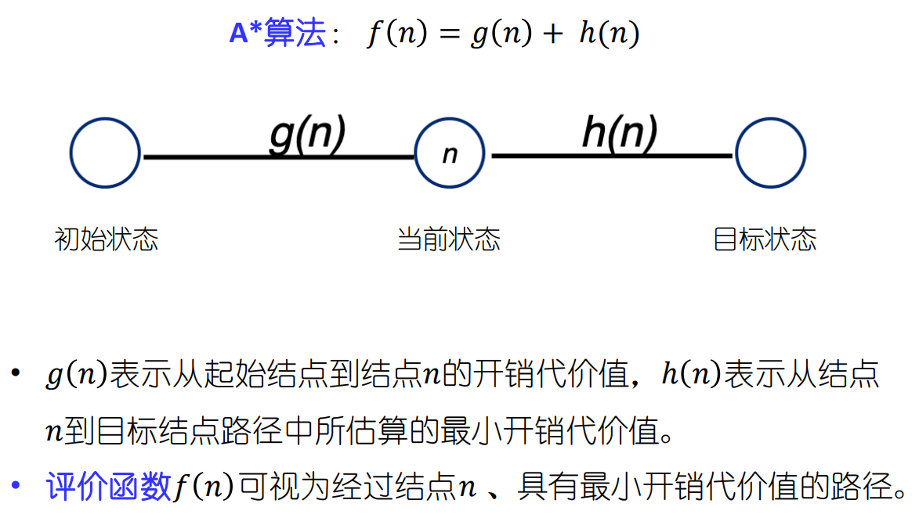
Review
A* algorithm cost(n) = c(n) +h(n)
c(n)
c(n)
cost(n)

Slide 6
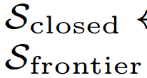
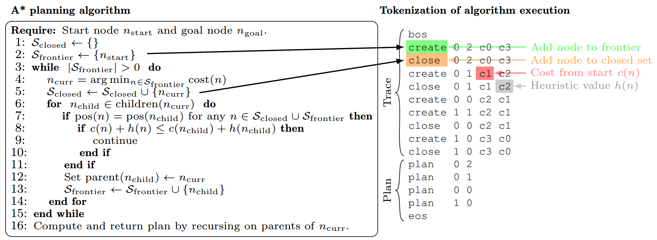
Execution Trace
all searched nodes
the current search frontiers
Manhattan distance
token sequence

Slide 7
Section 2
Trace Dropping

Slide 8
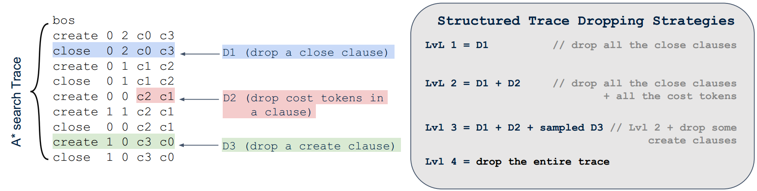
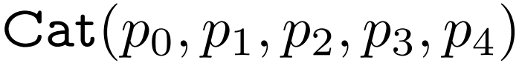
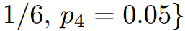
Structured trace dropping strategy
Motivation:
Results of previous experiments
Shortcuts (System 1 thinking)
Dropout technique
Training: Randomly sample the dropping strategy from
Experimental choice:

Slide 9
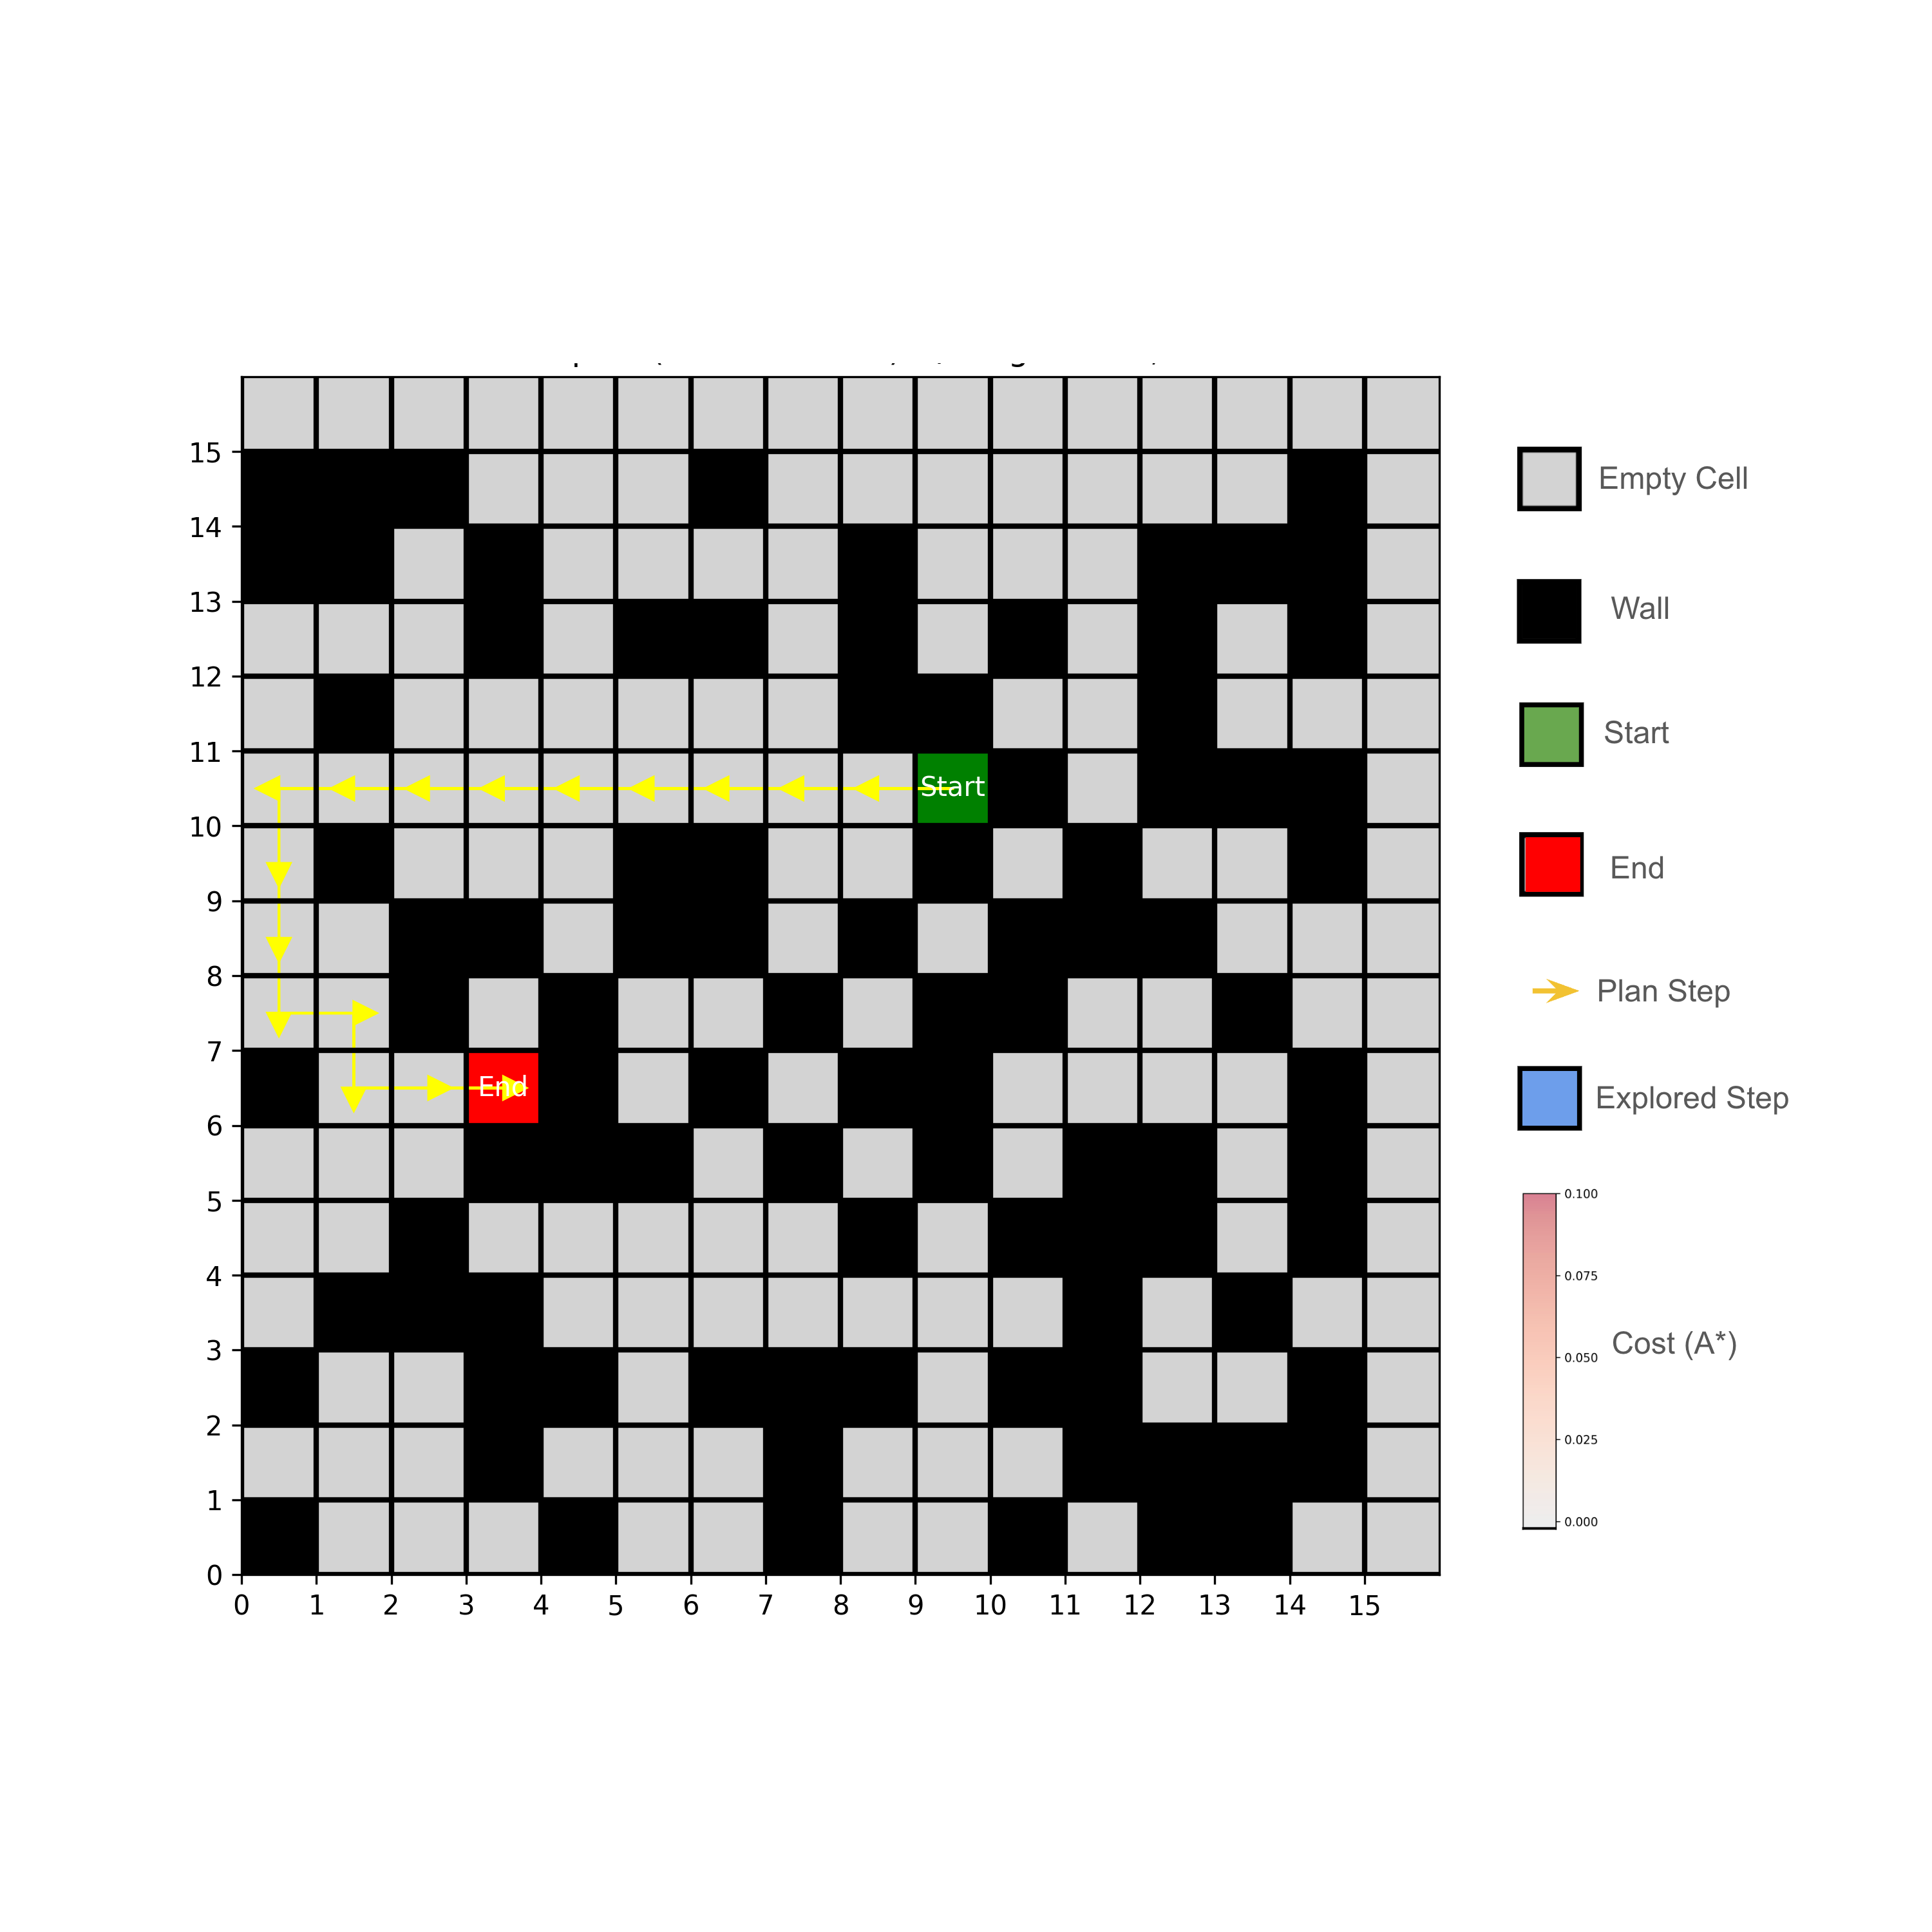
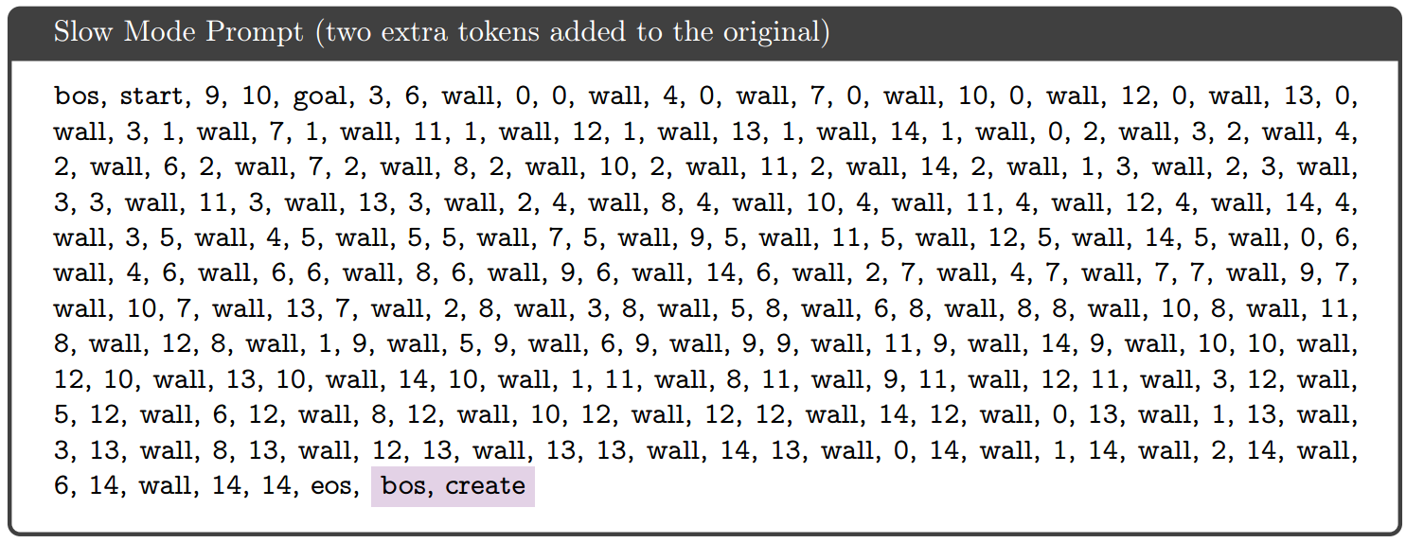
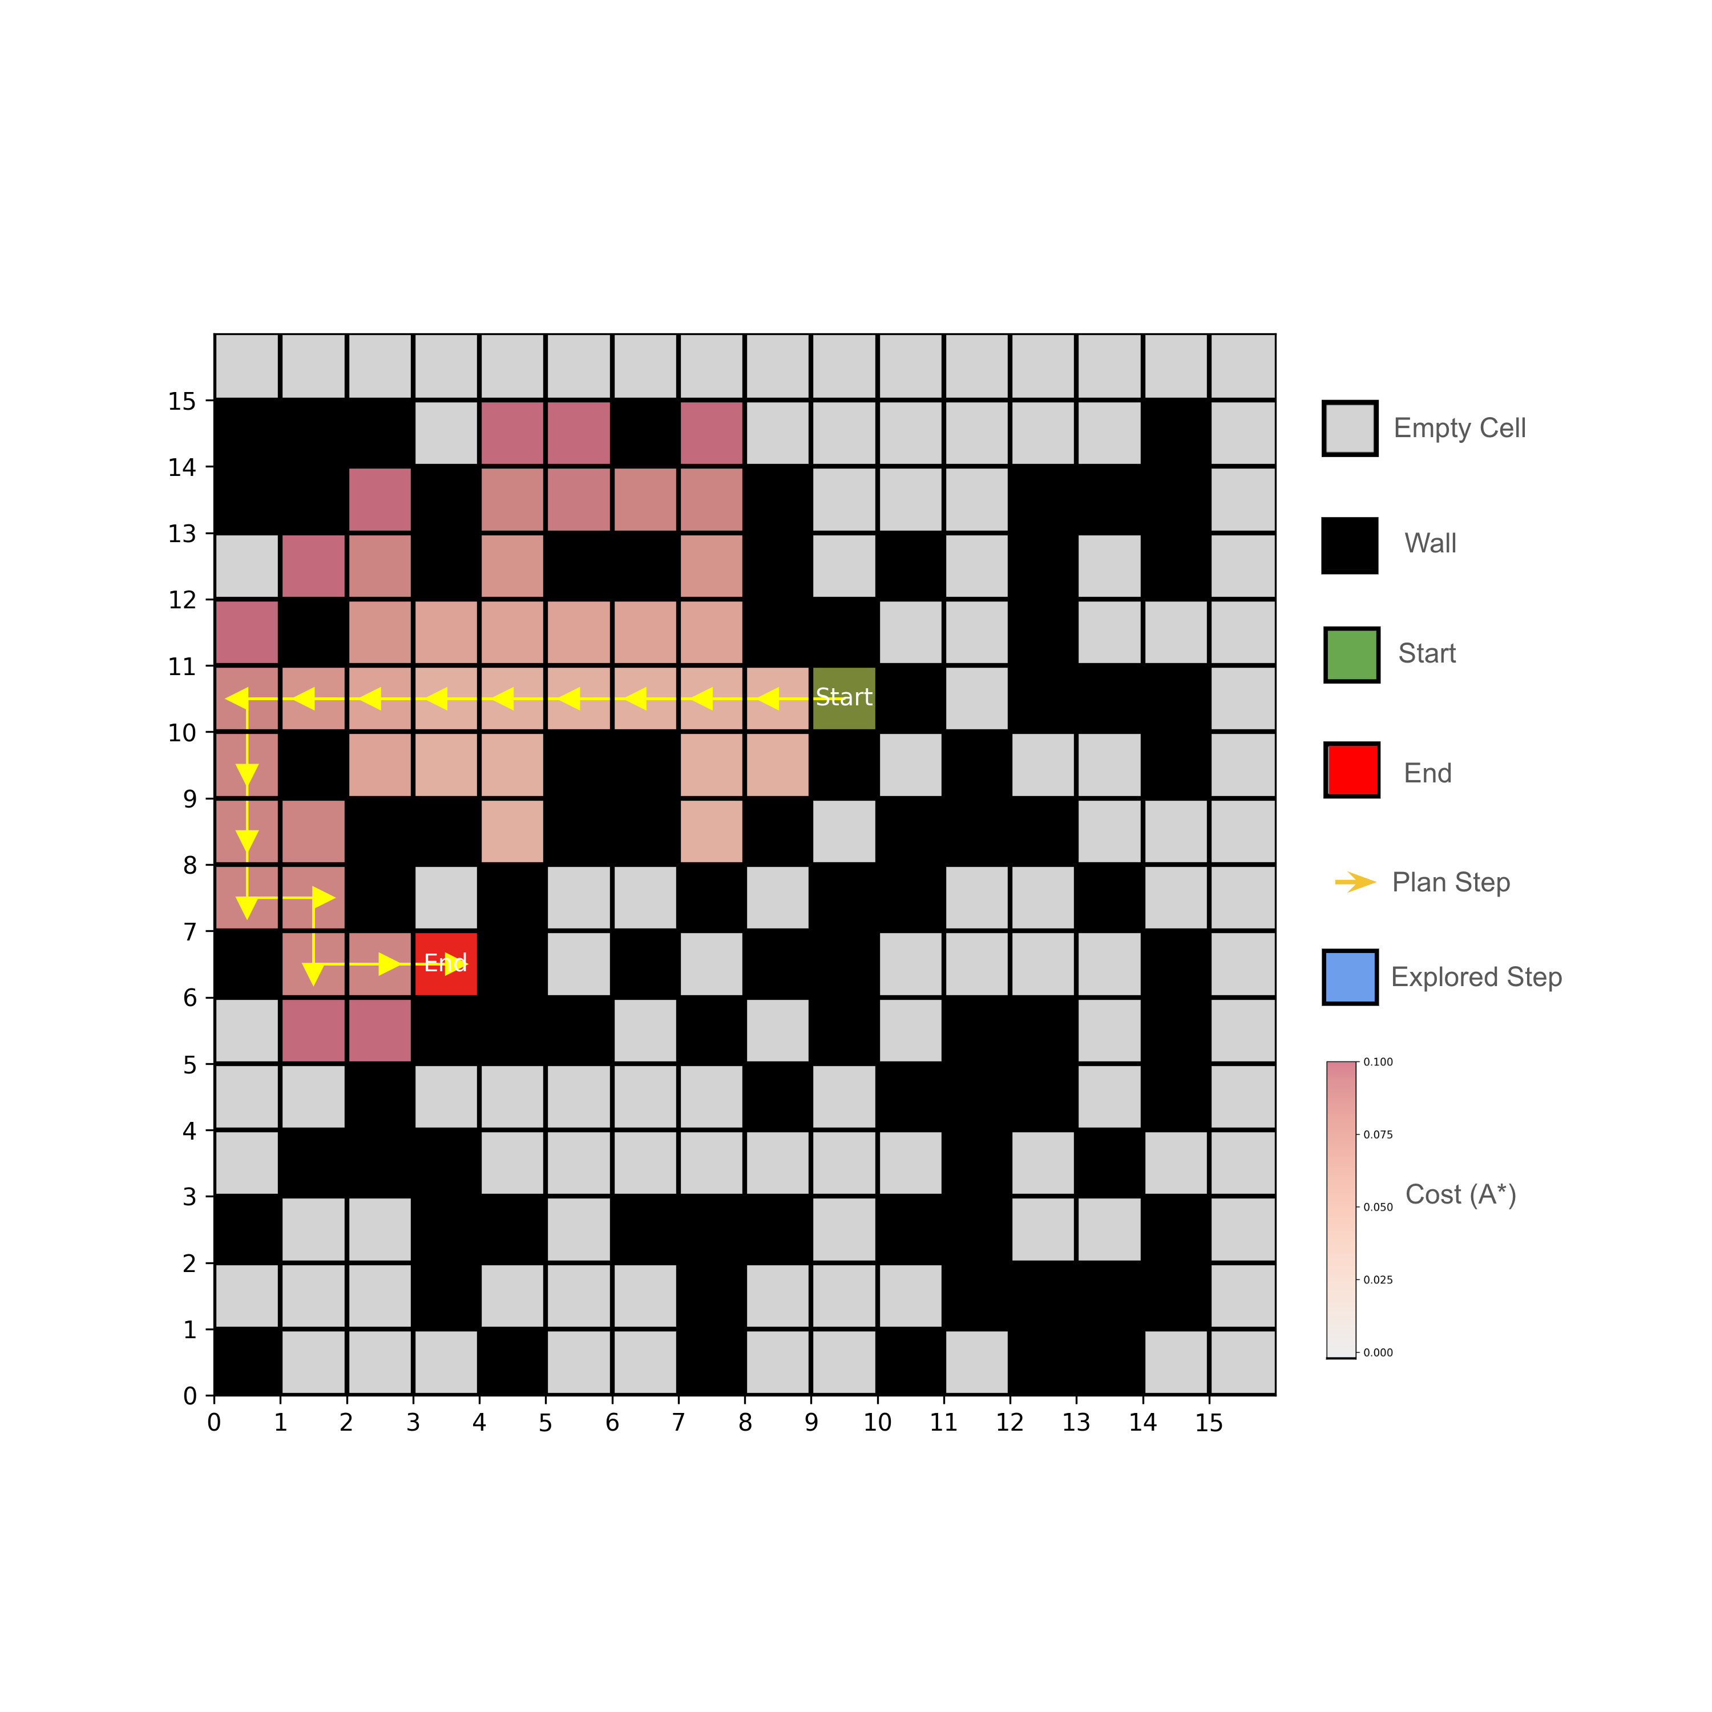
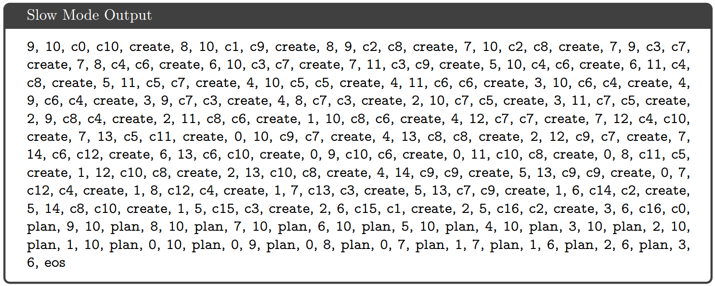
Controllable Generation (Slow Mode)
Inject a control token(create) after bos

Slide 10
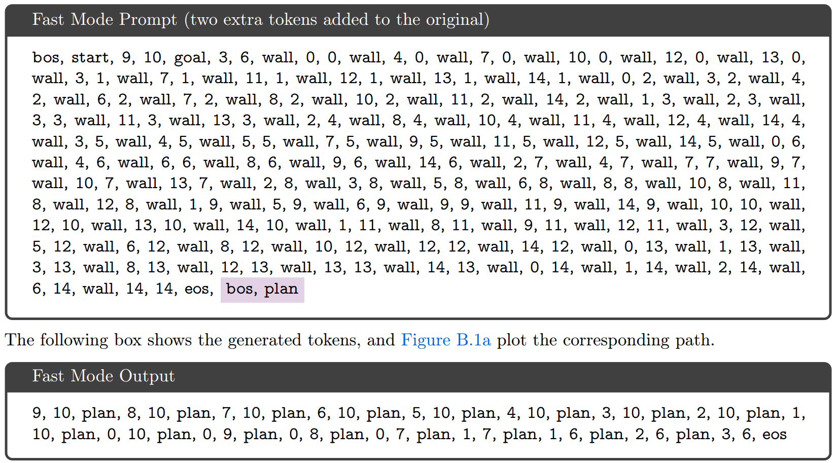
Controllable Generation (Fast Mode)
Inject a control token(plan) after bos

Slide 11
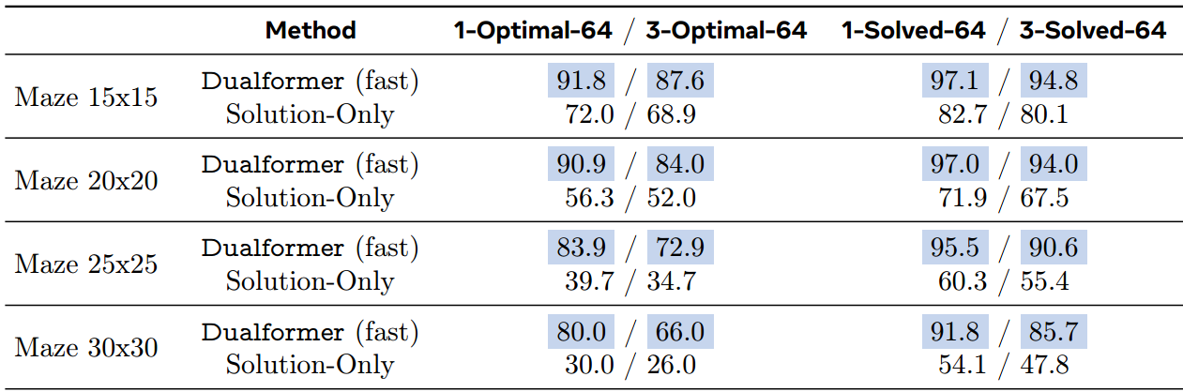
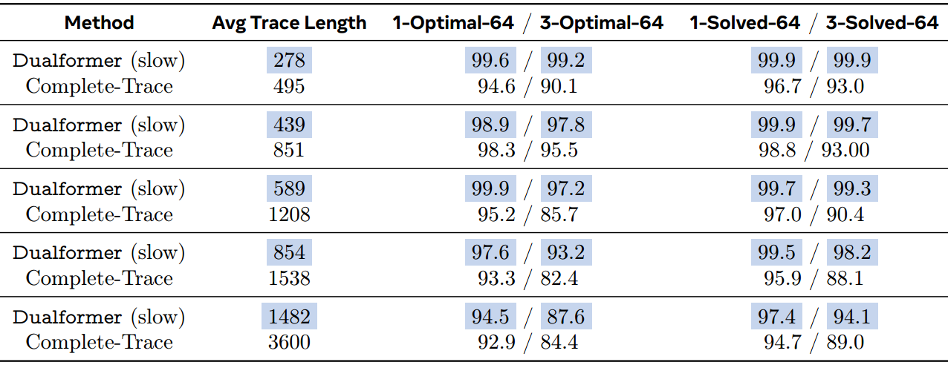
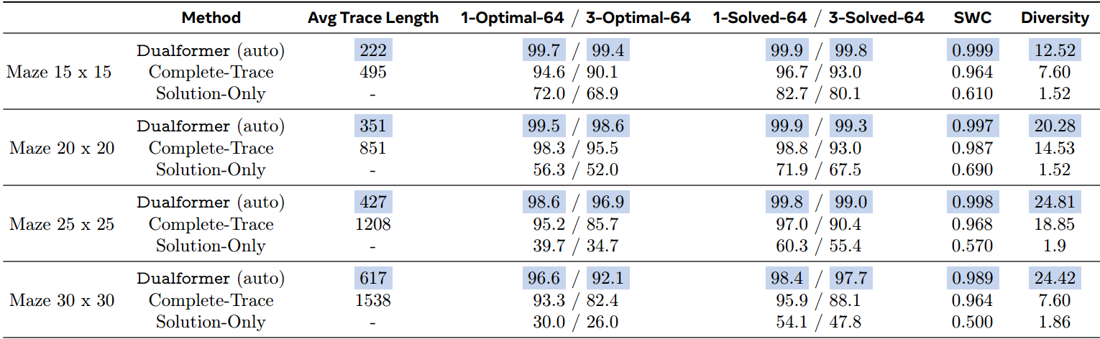
Experimental Results
facebookresearch/searchformer: Official codebase for the paper "Beyond A* Better Planning with Transformers via Search Dynamics Bootstrapping".
Following Lehnert et al. (2024), datasets contain ${10}^{5}$ training examples with complete A* search trace.
Comparison
Fast mode (Dualformer) VS Solution-Only model
Slow mode (Dualformer) VS Complete-Trace model
Auto mode (Dualformer) outperforms all models

Slide 12
Section 3
Application to LLM Training

Slide 13
Main Idea
Does the structured trace dropping technique generalize to LLMs trained on natural language datasets?
MATH Dataset (Math questions and brief answers)
Synthesize using LLM (search-augmented?)
Aug-MATH Dataset (Math questions and answers with detailed reasoning steps)
Randomized training procedure
Finetune LLMs to solve math problems

Slide 14
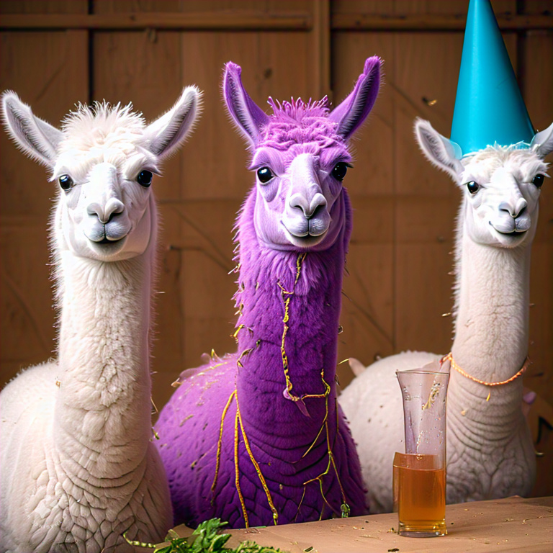
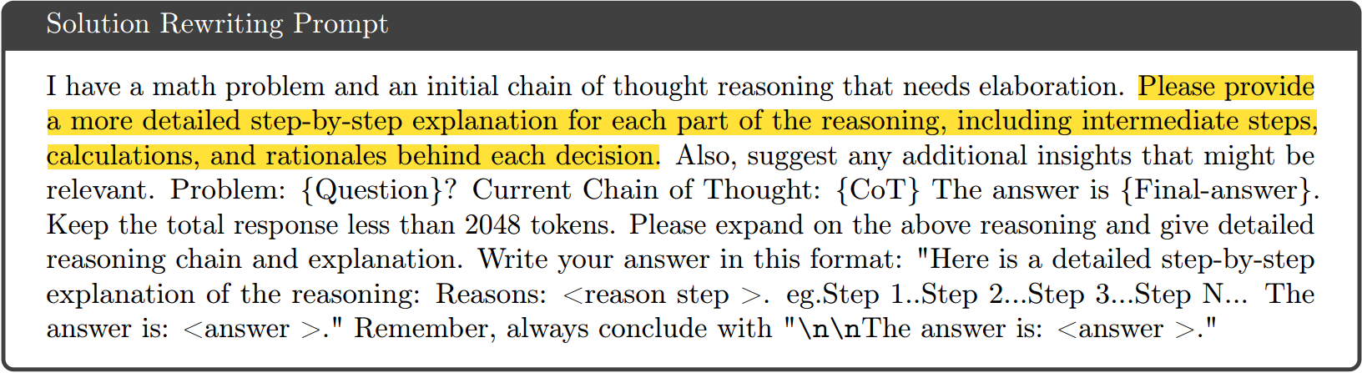
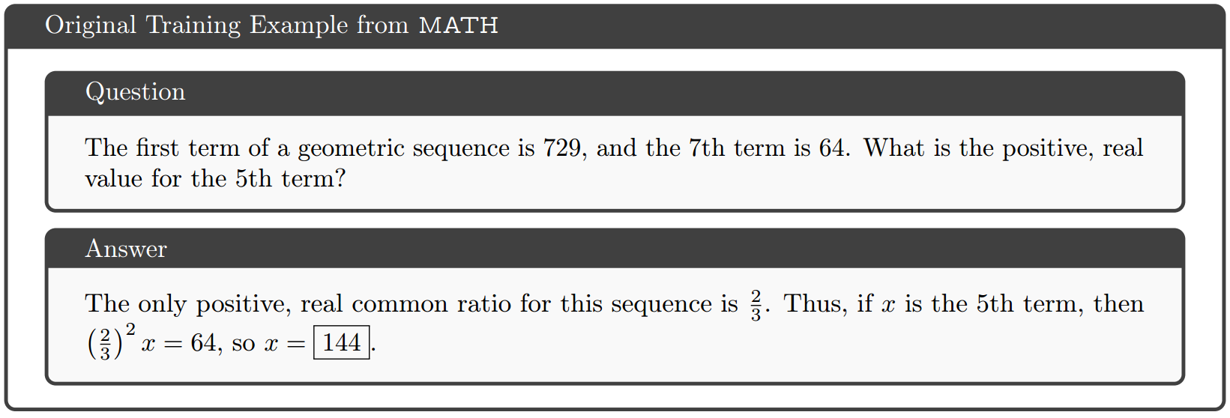
Synthetic Data Generation
MATH dataset
7500 training examples
5000 testing examples
Aug-MATH dataset
4×7500 training examples
5000 testing examples
Llama-3.1-70B -Instruct
Rewrite solutions to include intermediate steps

Slide 15
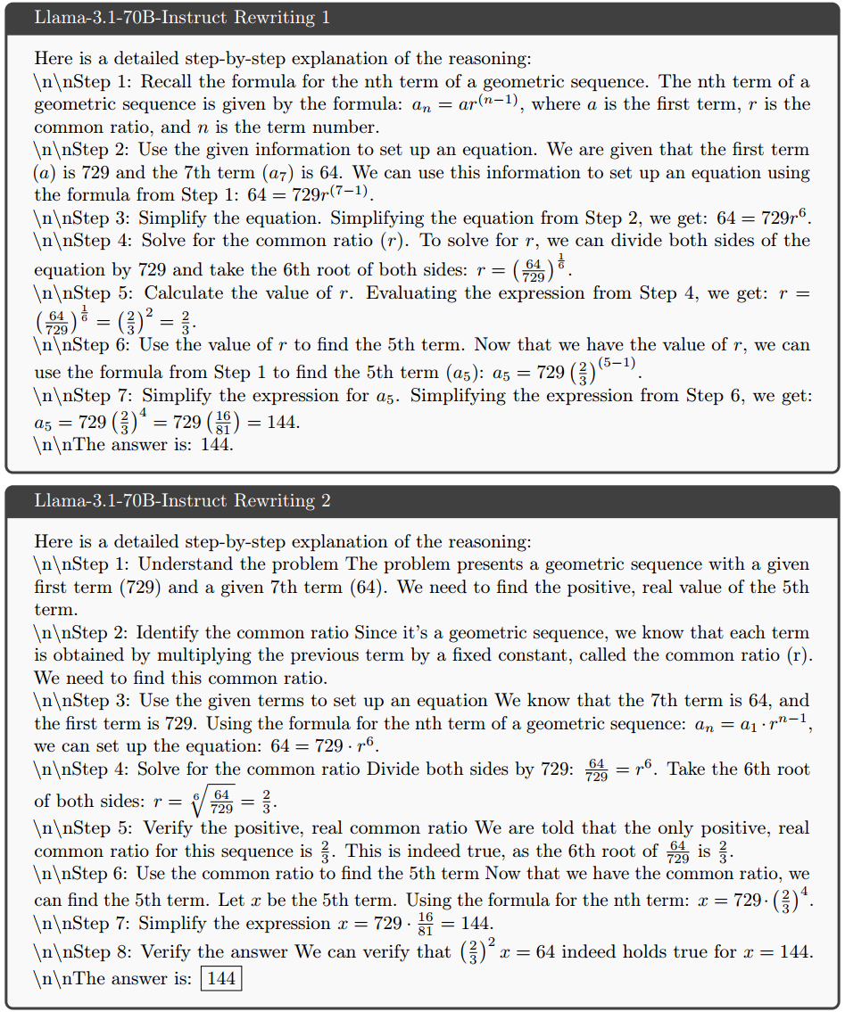
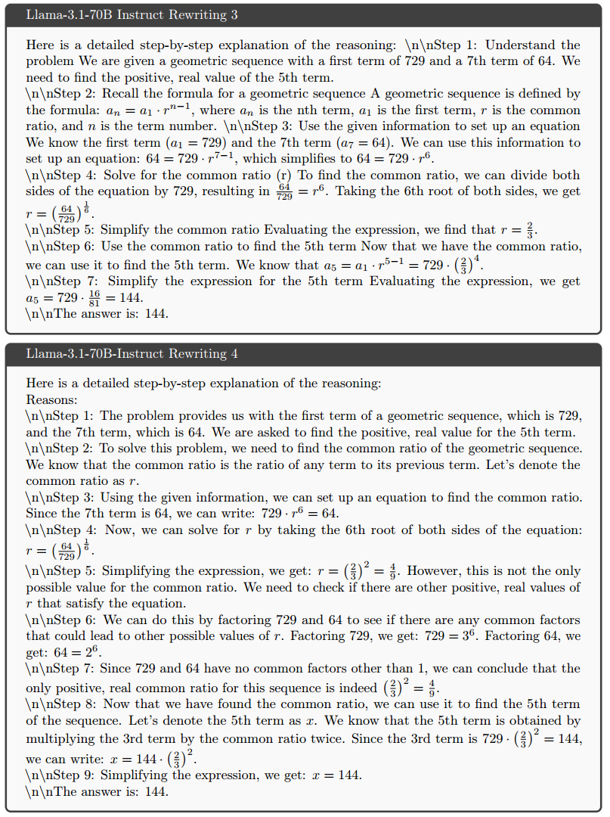
Aug-MATH Dataset
6-10 intermediate reasoning steps on average
every step might contain multiple sentences

Slide 16
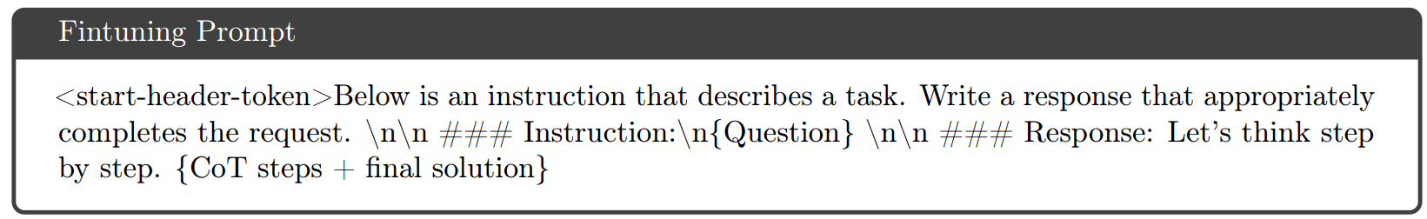
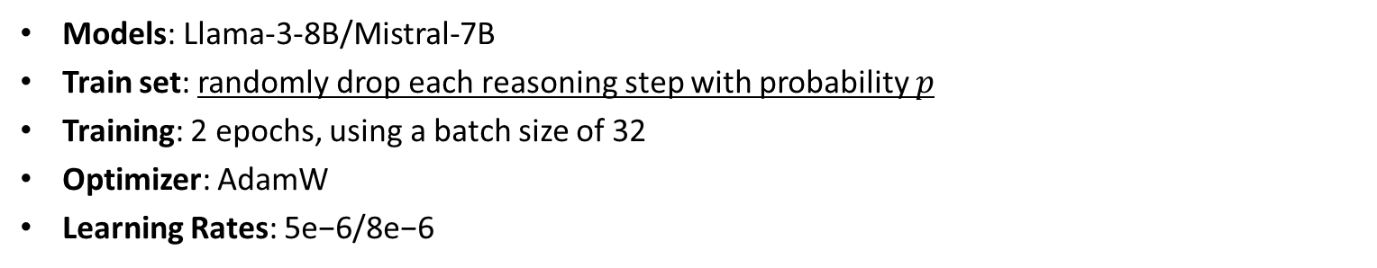
Finetune Details
We use the implementation provided at meta-llama/llama-recipes for finetuning the models.
Models: Llama-3-8B/Mistral-7B
Train set: randomly drop each reasoning step with probability $p$
Training: 2 epochs, using a batch size of 32
Optimizer: AdamW
Learning Rates: 5e−6/8e−6

Slide 17
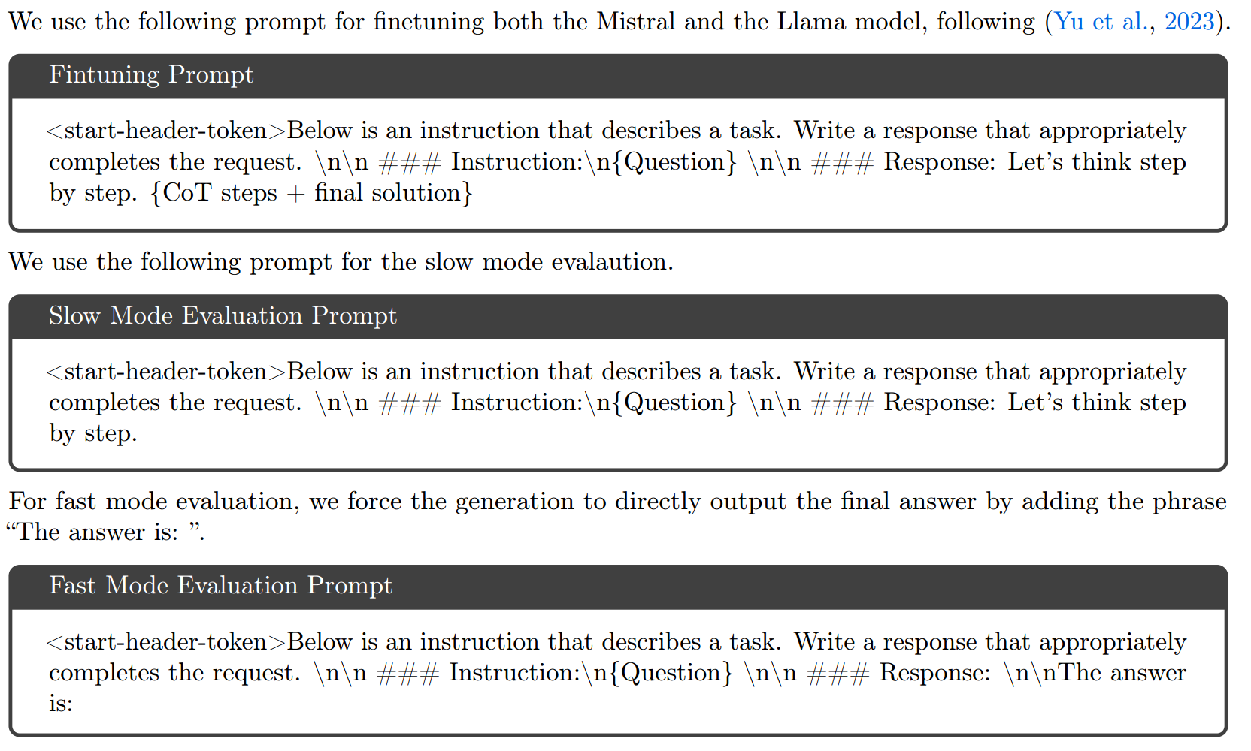
Evaluation
We use zero-shot prompting when evaluating the models:
Performance Measurement
Greedy@1 metric: generate 1 response using a temperature of 0
pass@20 metric: randomly sample 20 responses using a temperature of 0.5

Slide 18
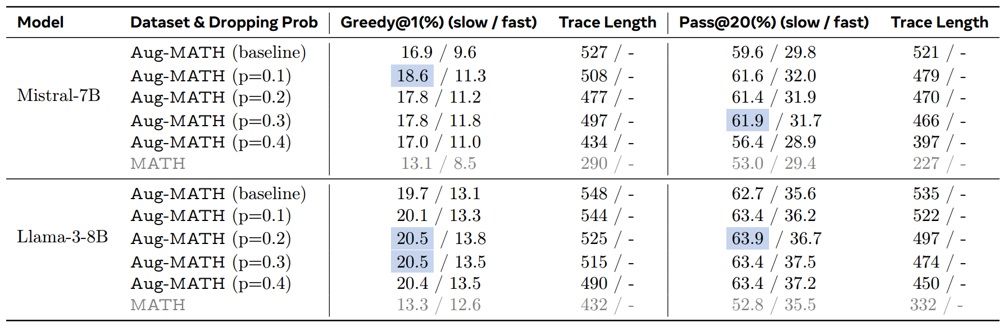
Results
We test four values of p: 0.1, 0.2, 0.3 and 0.4 and evaluate the models in both the fast and the slow mode.
Aug-MATH VS MATH
Baseline VS Trace Dropping

Slide 19
Summary
Problem: Sequence to Sequence
Solution: Step by step (trace)
Dataset: trace dropping (synthesis)

